Slide 1

Genomic & Gut Microbial Attributes of Body Mass Index (BMI)
Zachary Caterer | Dr. Maggie Stanislawski
University of Colorado Boulder Department of Chemical and Biological Engineering + IQ Biology | University of Colorado Anschutz Department of Biomedical Informatics + Biofrontiers Institute

Slide 2
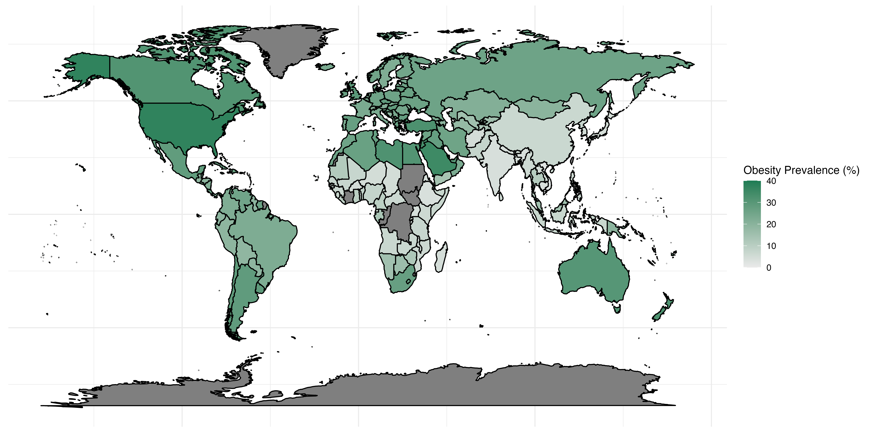
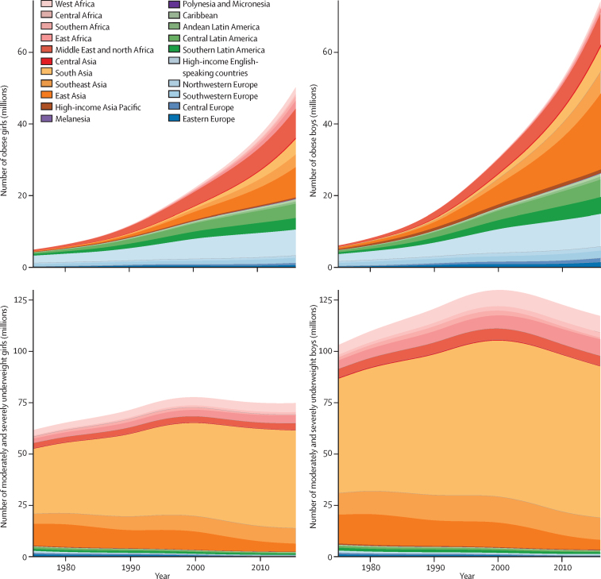

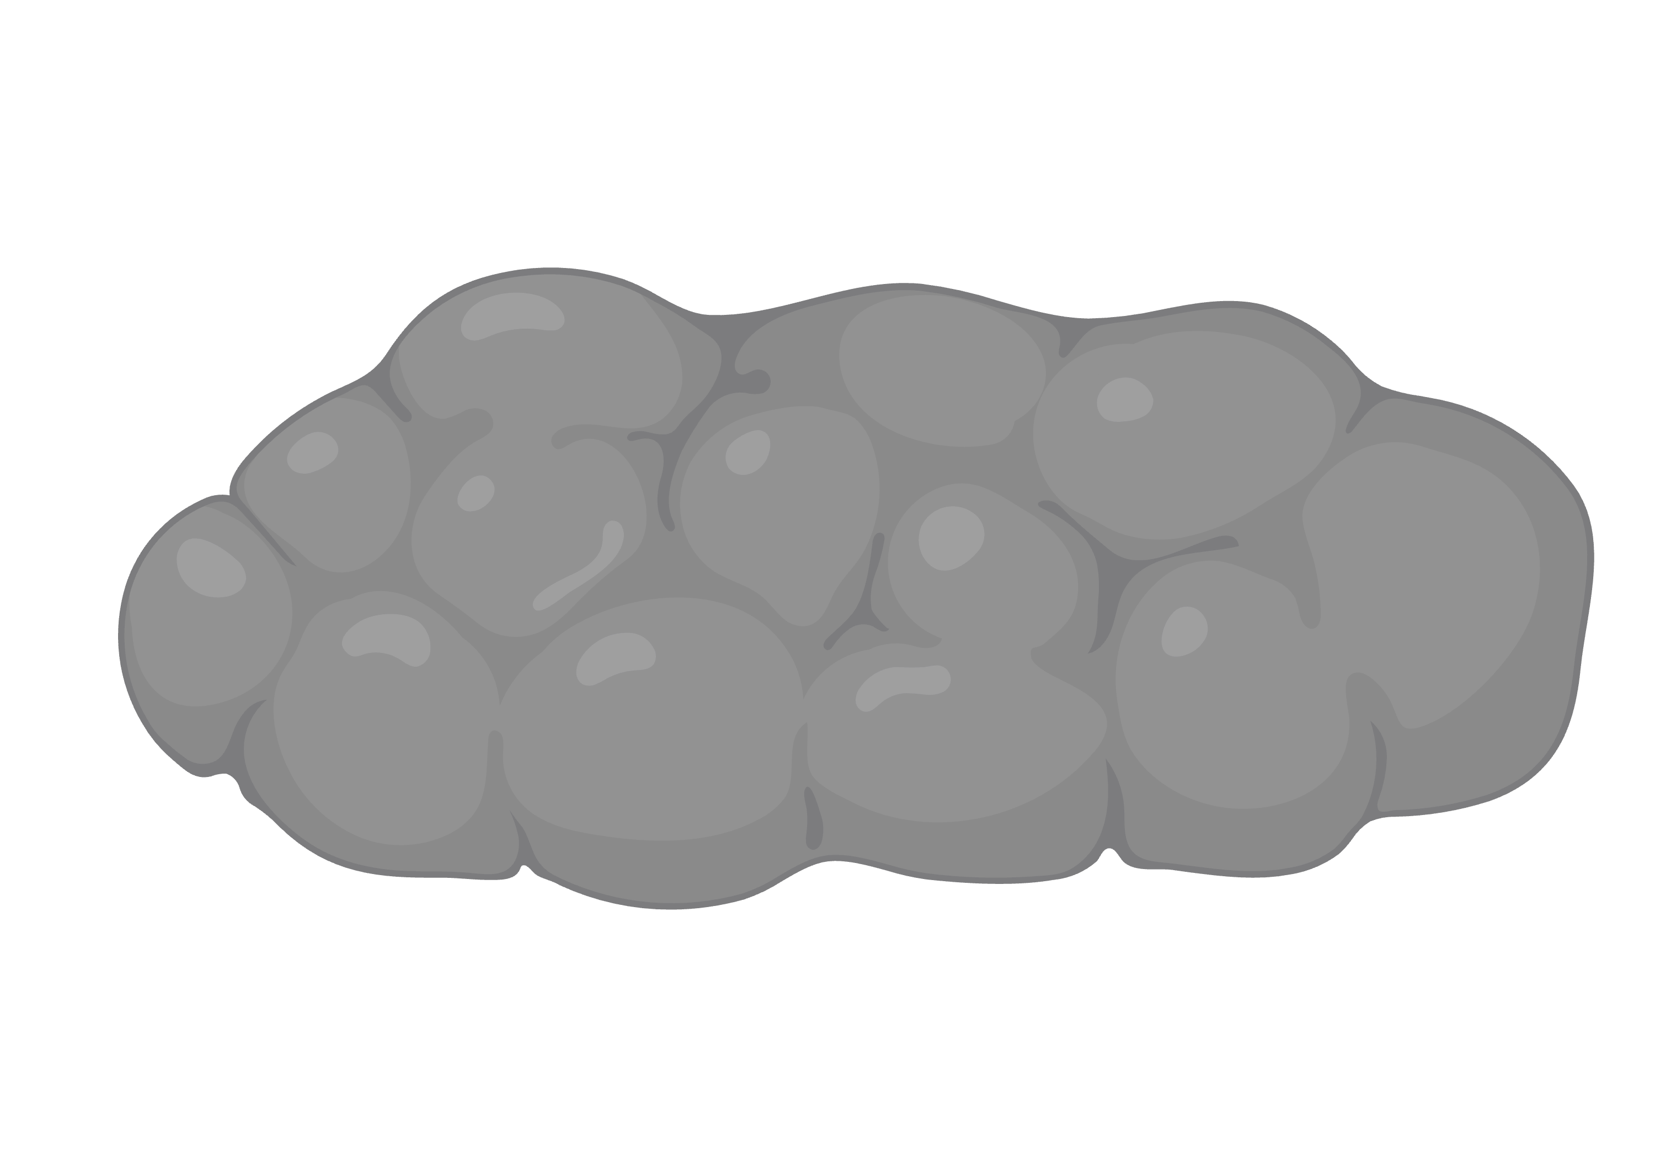
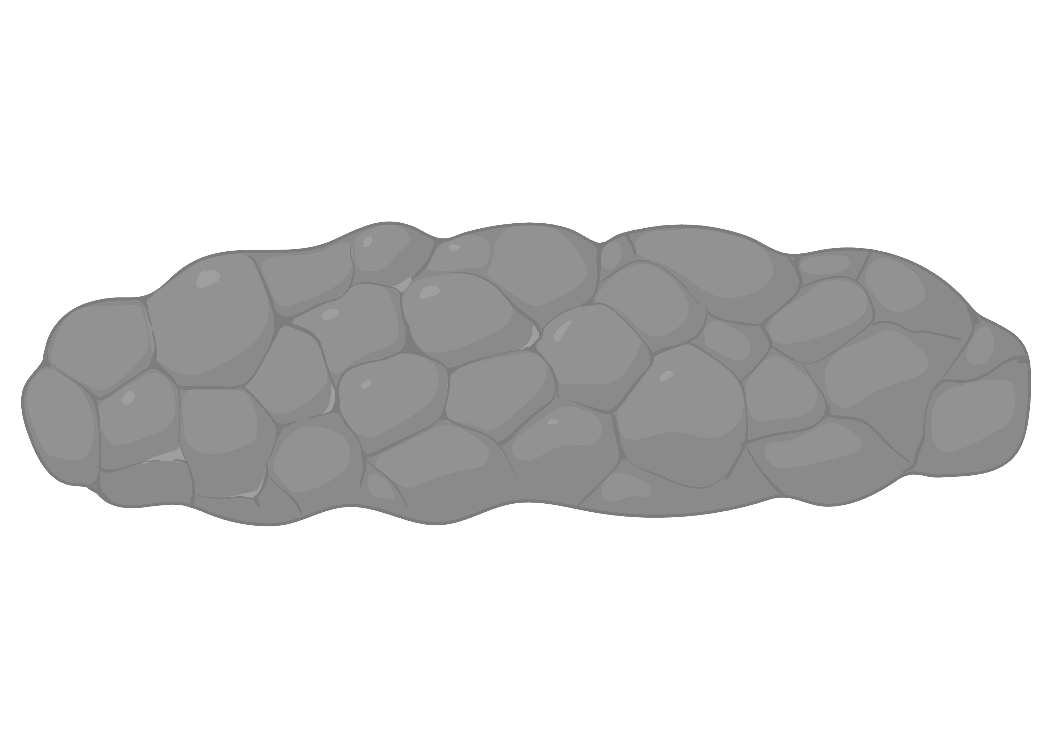
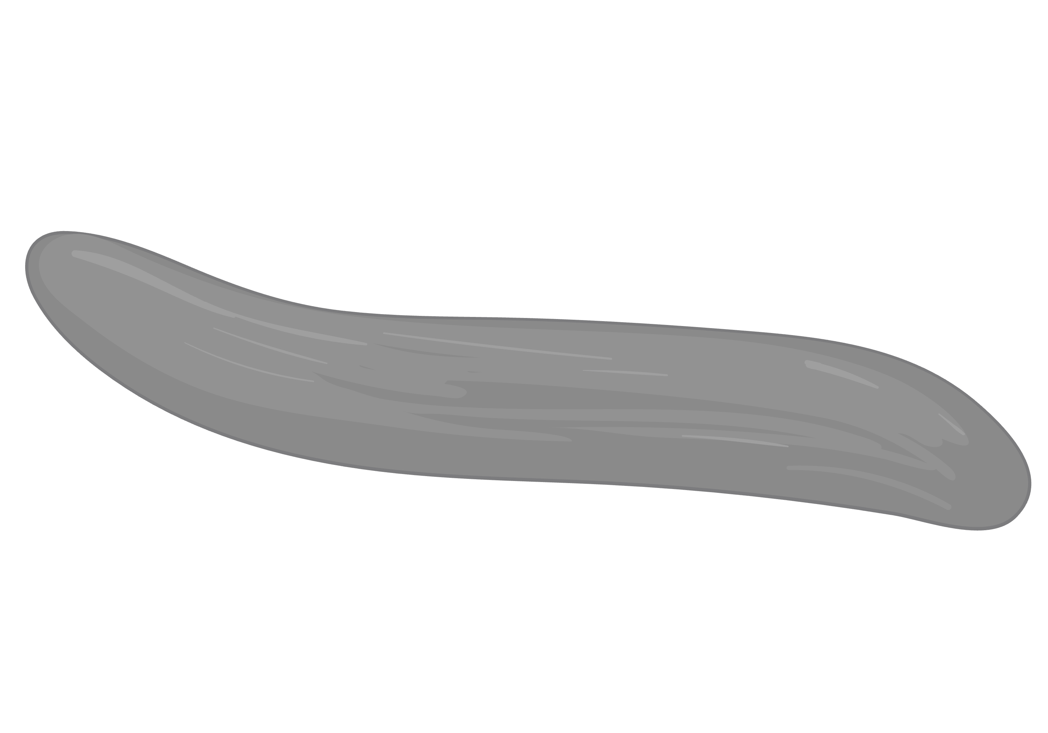


Obesity is an epidemic
Hannah Ritchie and Max Roser (2017) - OurWorldinData.org
NCD Risk Factor Collaboration (2017)

Slide 3
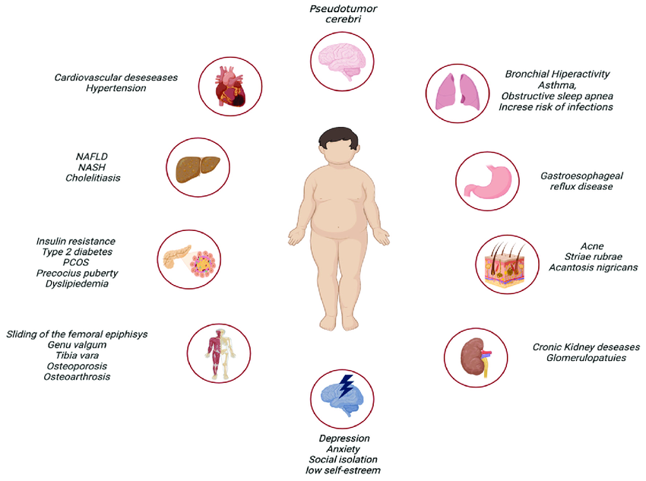
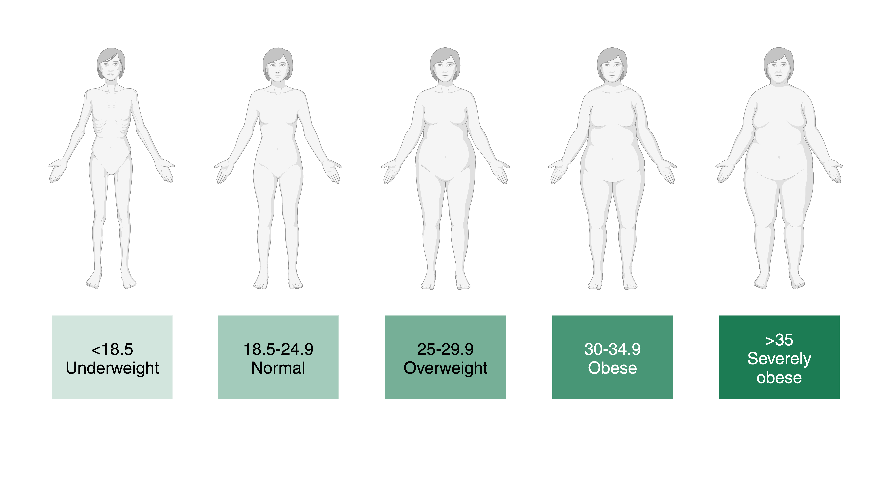
Obesity is a chronic disease
Calcaterra et al. 2023
Notes:
Body Mass index is a calculation that measures body weight relative to height
Weight (kg) / Height (m)
BMI is not the whole story and other factors should be considered

Slide 4
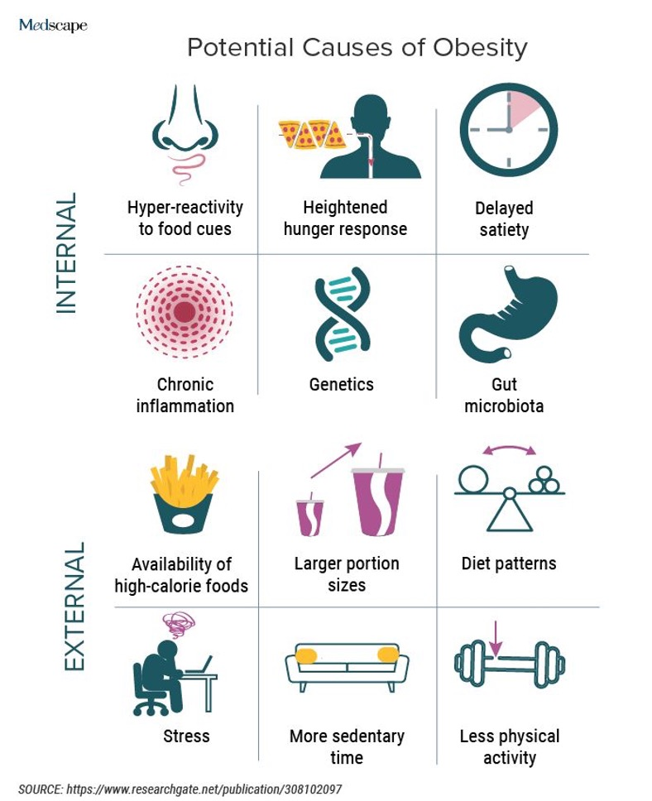
Potential Causes of Obesity

Slide 5
Potential Causes of Obesity

Slide 6
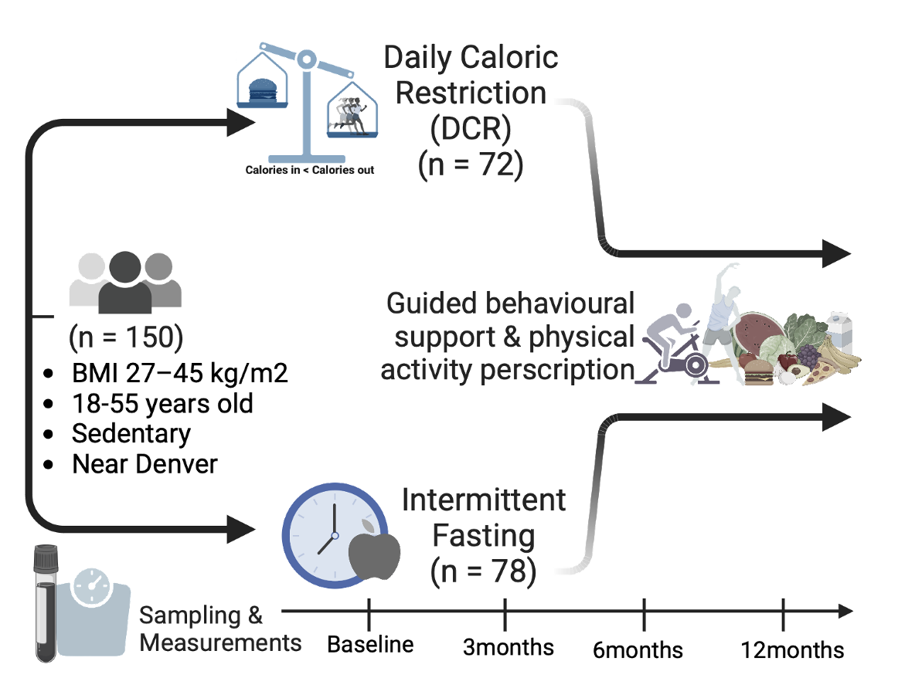
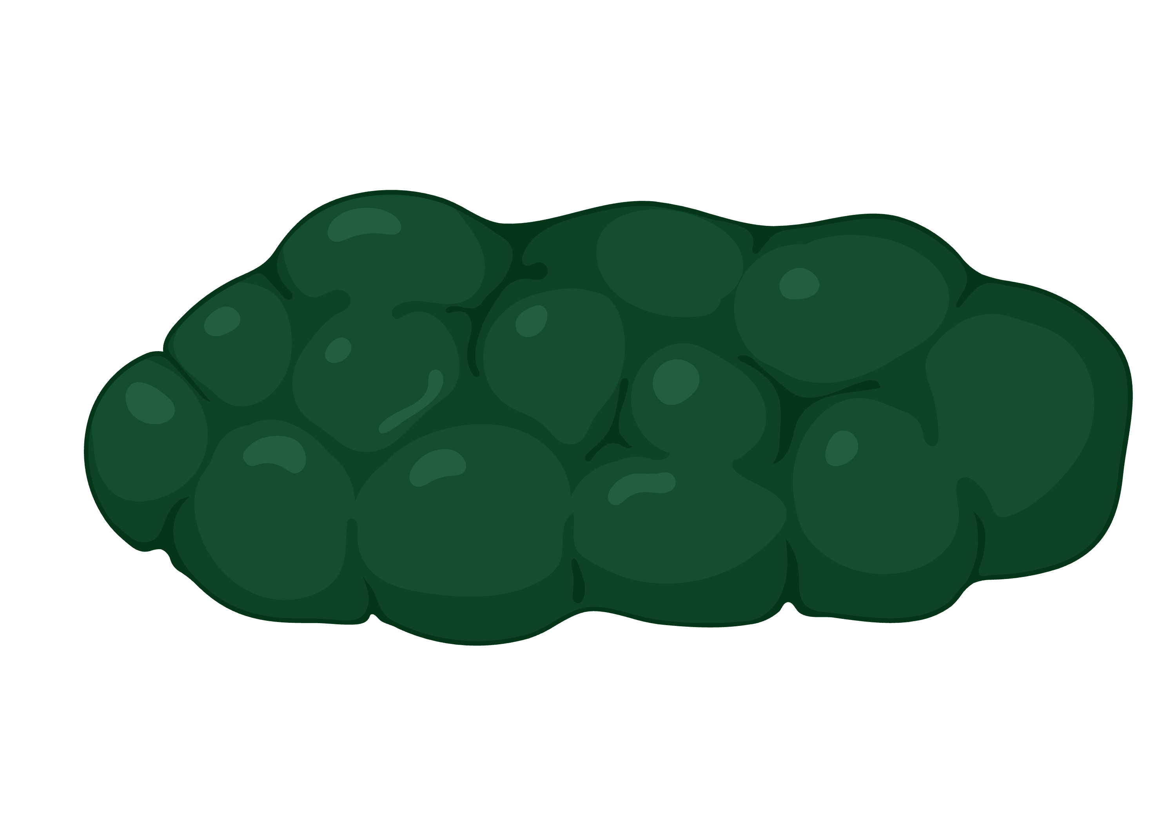
Daily Caloric Restriction vs Intermittent Fasting Trial
DRIFT
DRIFT
Notes:
Study done at CU Anschutz Wellness Center, Participants from the Aurora / Denver area

Slide 7
Daily Caloric Restriction vs Intermittent Fasting Trial
DRIFT
DRIFT

Slide 8
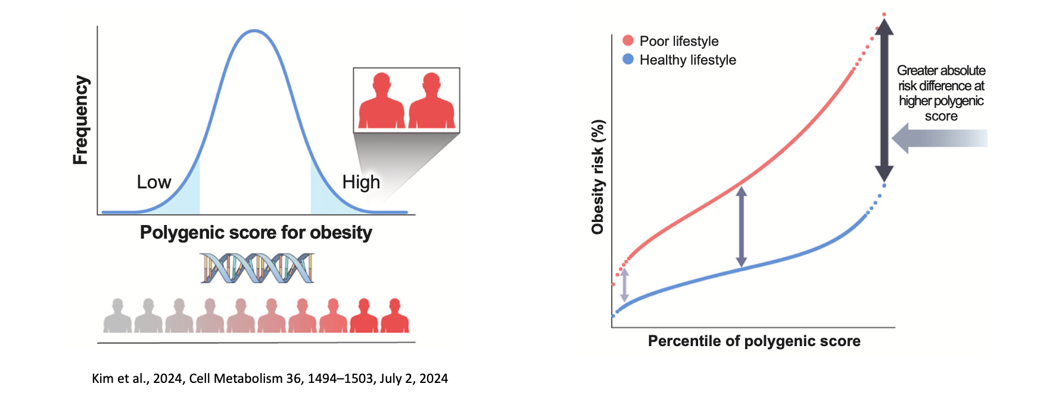
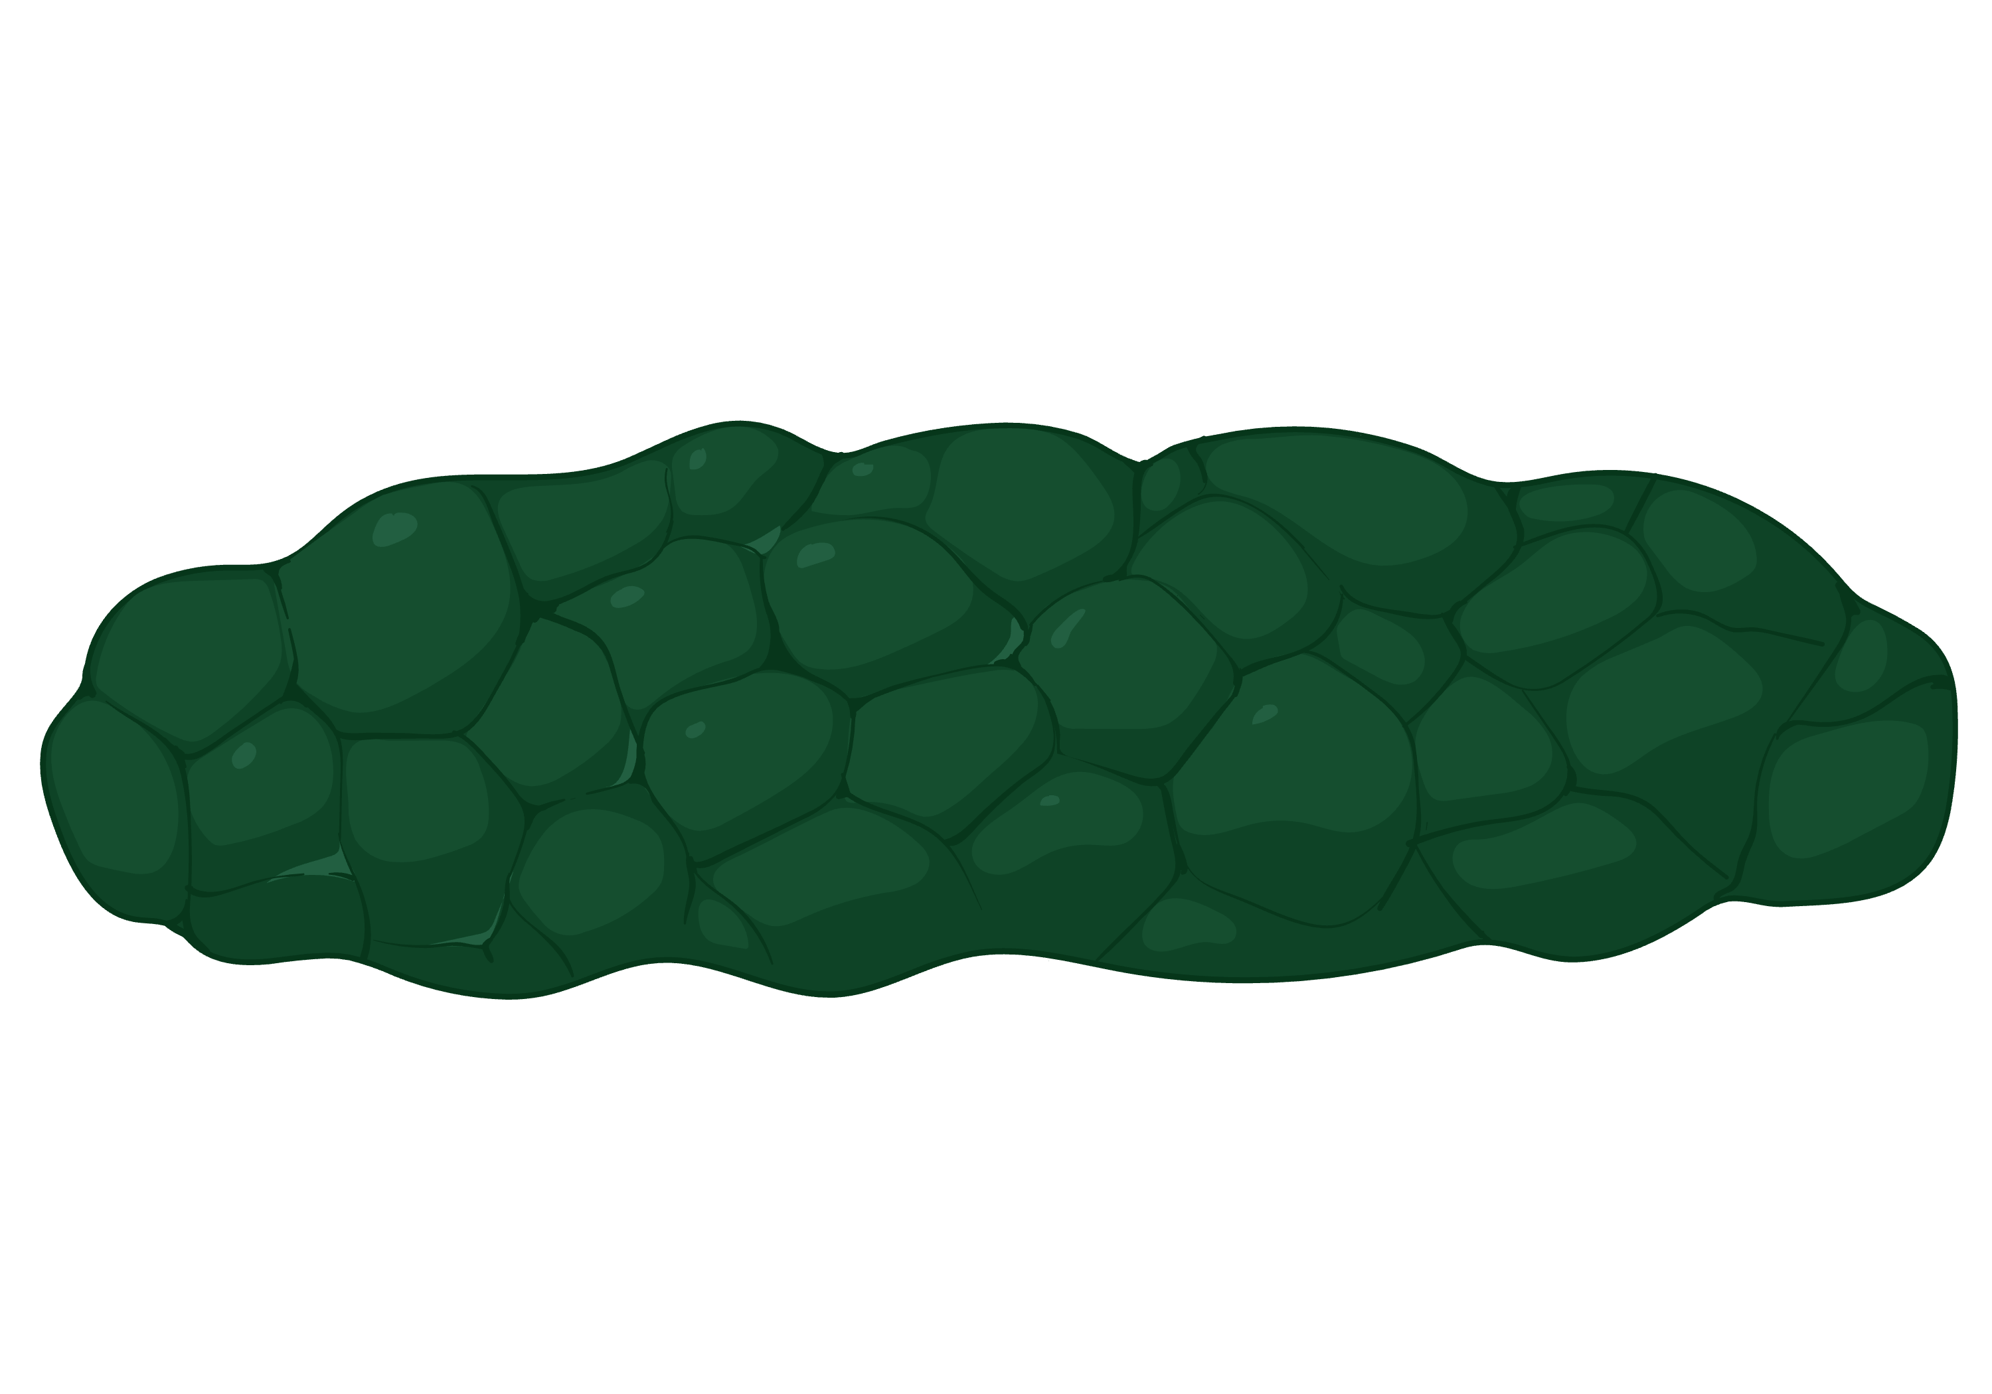
Research Questions
Are there associations between participant BMI genetic risk scores and weight loss?
Increased risk of obesity and obesity related morbidities in high genetic risk group
Healthy lifestyle can prevent multi-morbidities even for individual at high genetic risk
Notes:
(Left)
- Some diseases are monogenic, one area of genome is important such as sickle cell anemia, a single single nucleotide polymorphism
- Many chronic diseases are polygenic, where multiple areas of the genome are important such as cardiovascular, neurological, and metabolic — obesity.
-People who have extreme polygenic risk score have notably high risk for disease
(Right)
- Possible that other internal factors can offset your risk score such as modifiable factors including the gut microbiome.
- Adherence to a healthy lifestyle (minimal obesogenic behaviors) is associated with a reduced risk of obesity and obesity-related morbidities across all genetic backgrounds.

Slide 9
Research Questions
Are there associations between participant BMI genetic risk scores and weight loss?
Are there gut microbial attributes that can be used to identify the difference in participant’s actual BMI vs genetic risk?

Slide 10
Research Questions
Are there associations between participant BMI genetic risk scores and weight loss?
(Emily Yeo & Ashley Scadden)
Are there gut microbial attributes that can be used to identify the difference in participant’s actual BMI vs genetic risk?

Slide 11
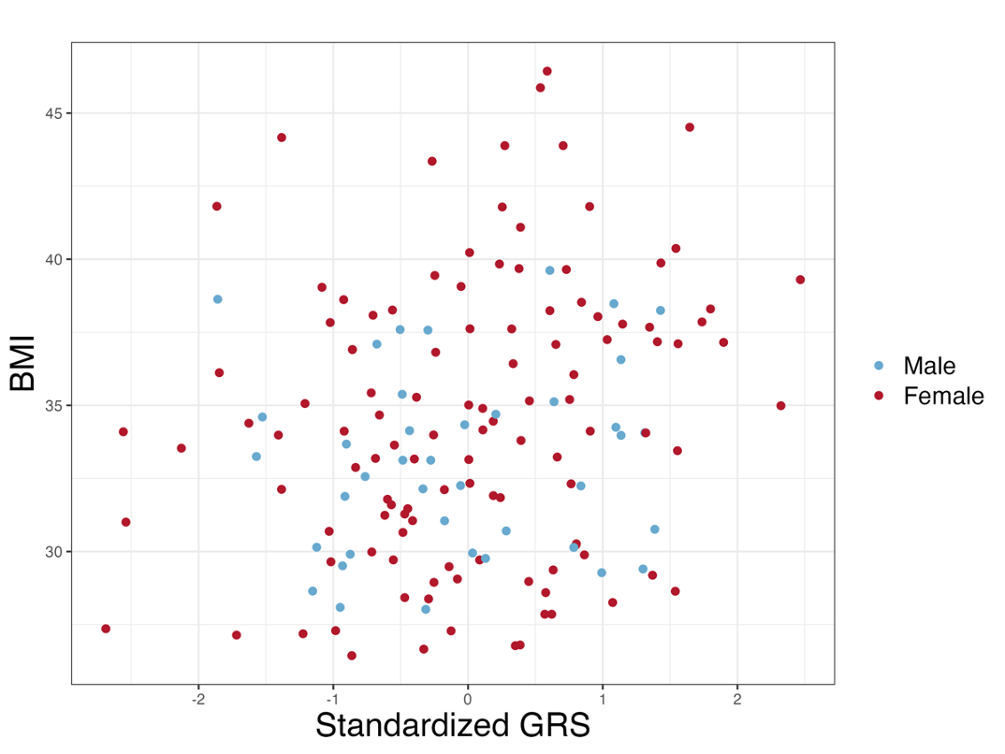
BMI verses genetically expected BMI — Genetic Risk Score (GRS)
GRS<BMI
Environment?
GRS>BMI
Notes:
Things on alignment, what we expect, then in the other corners are what we would not expect and maybe the environment have a larger role

Slide 12
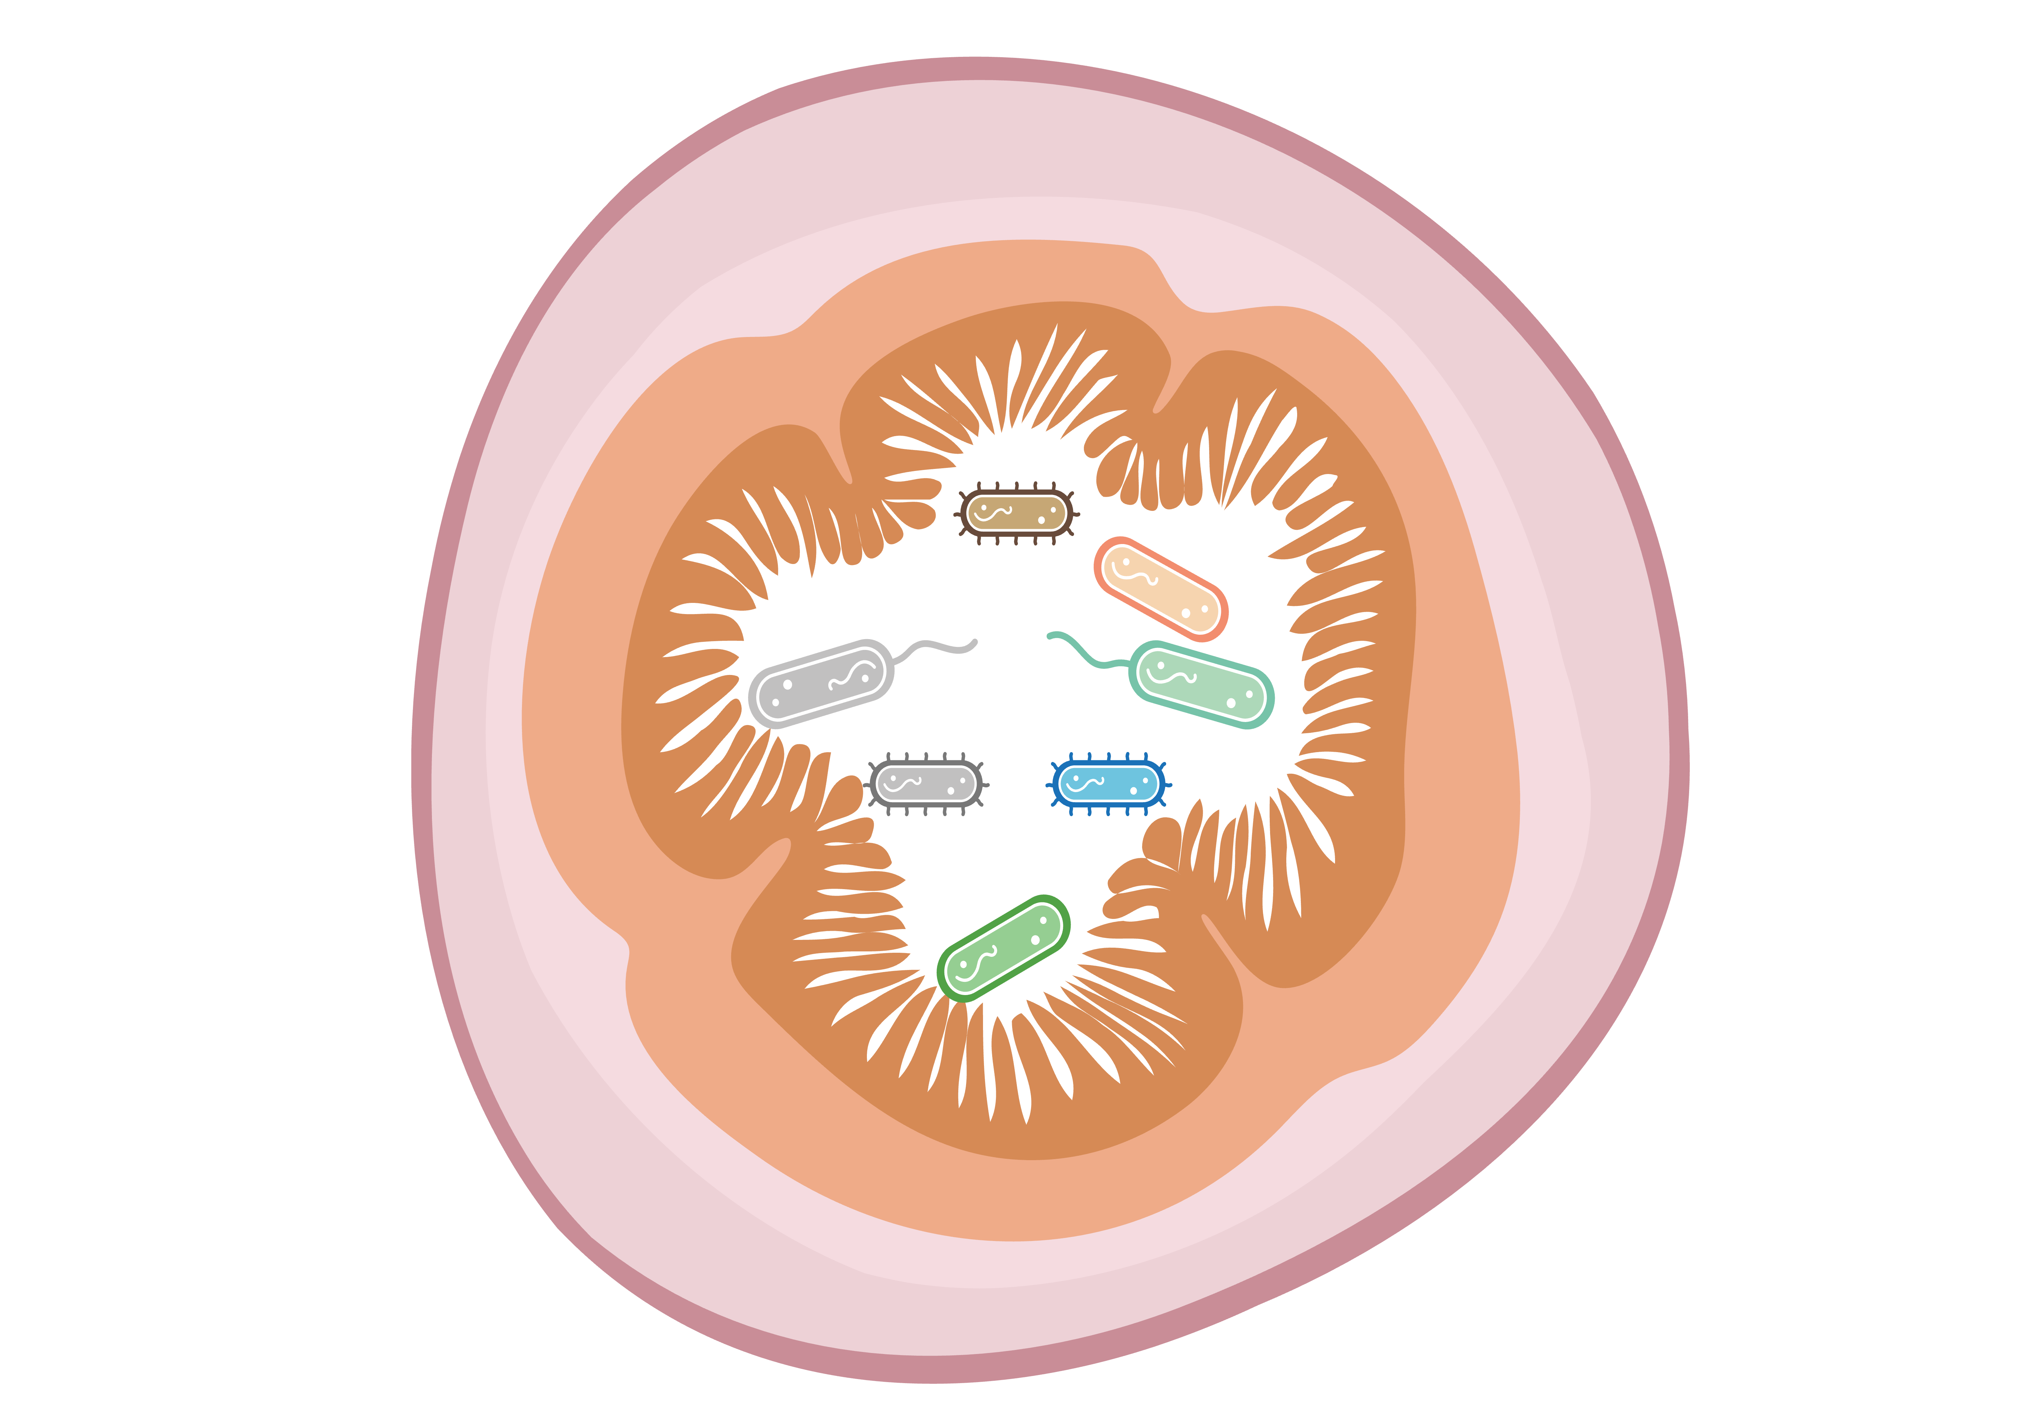
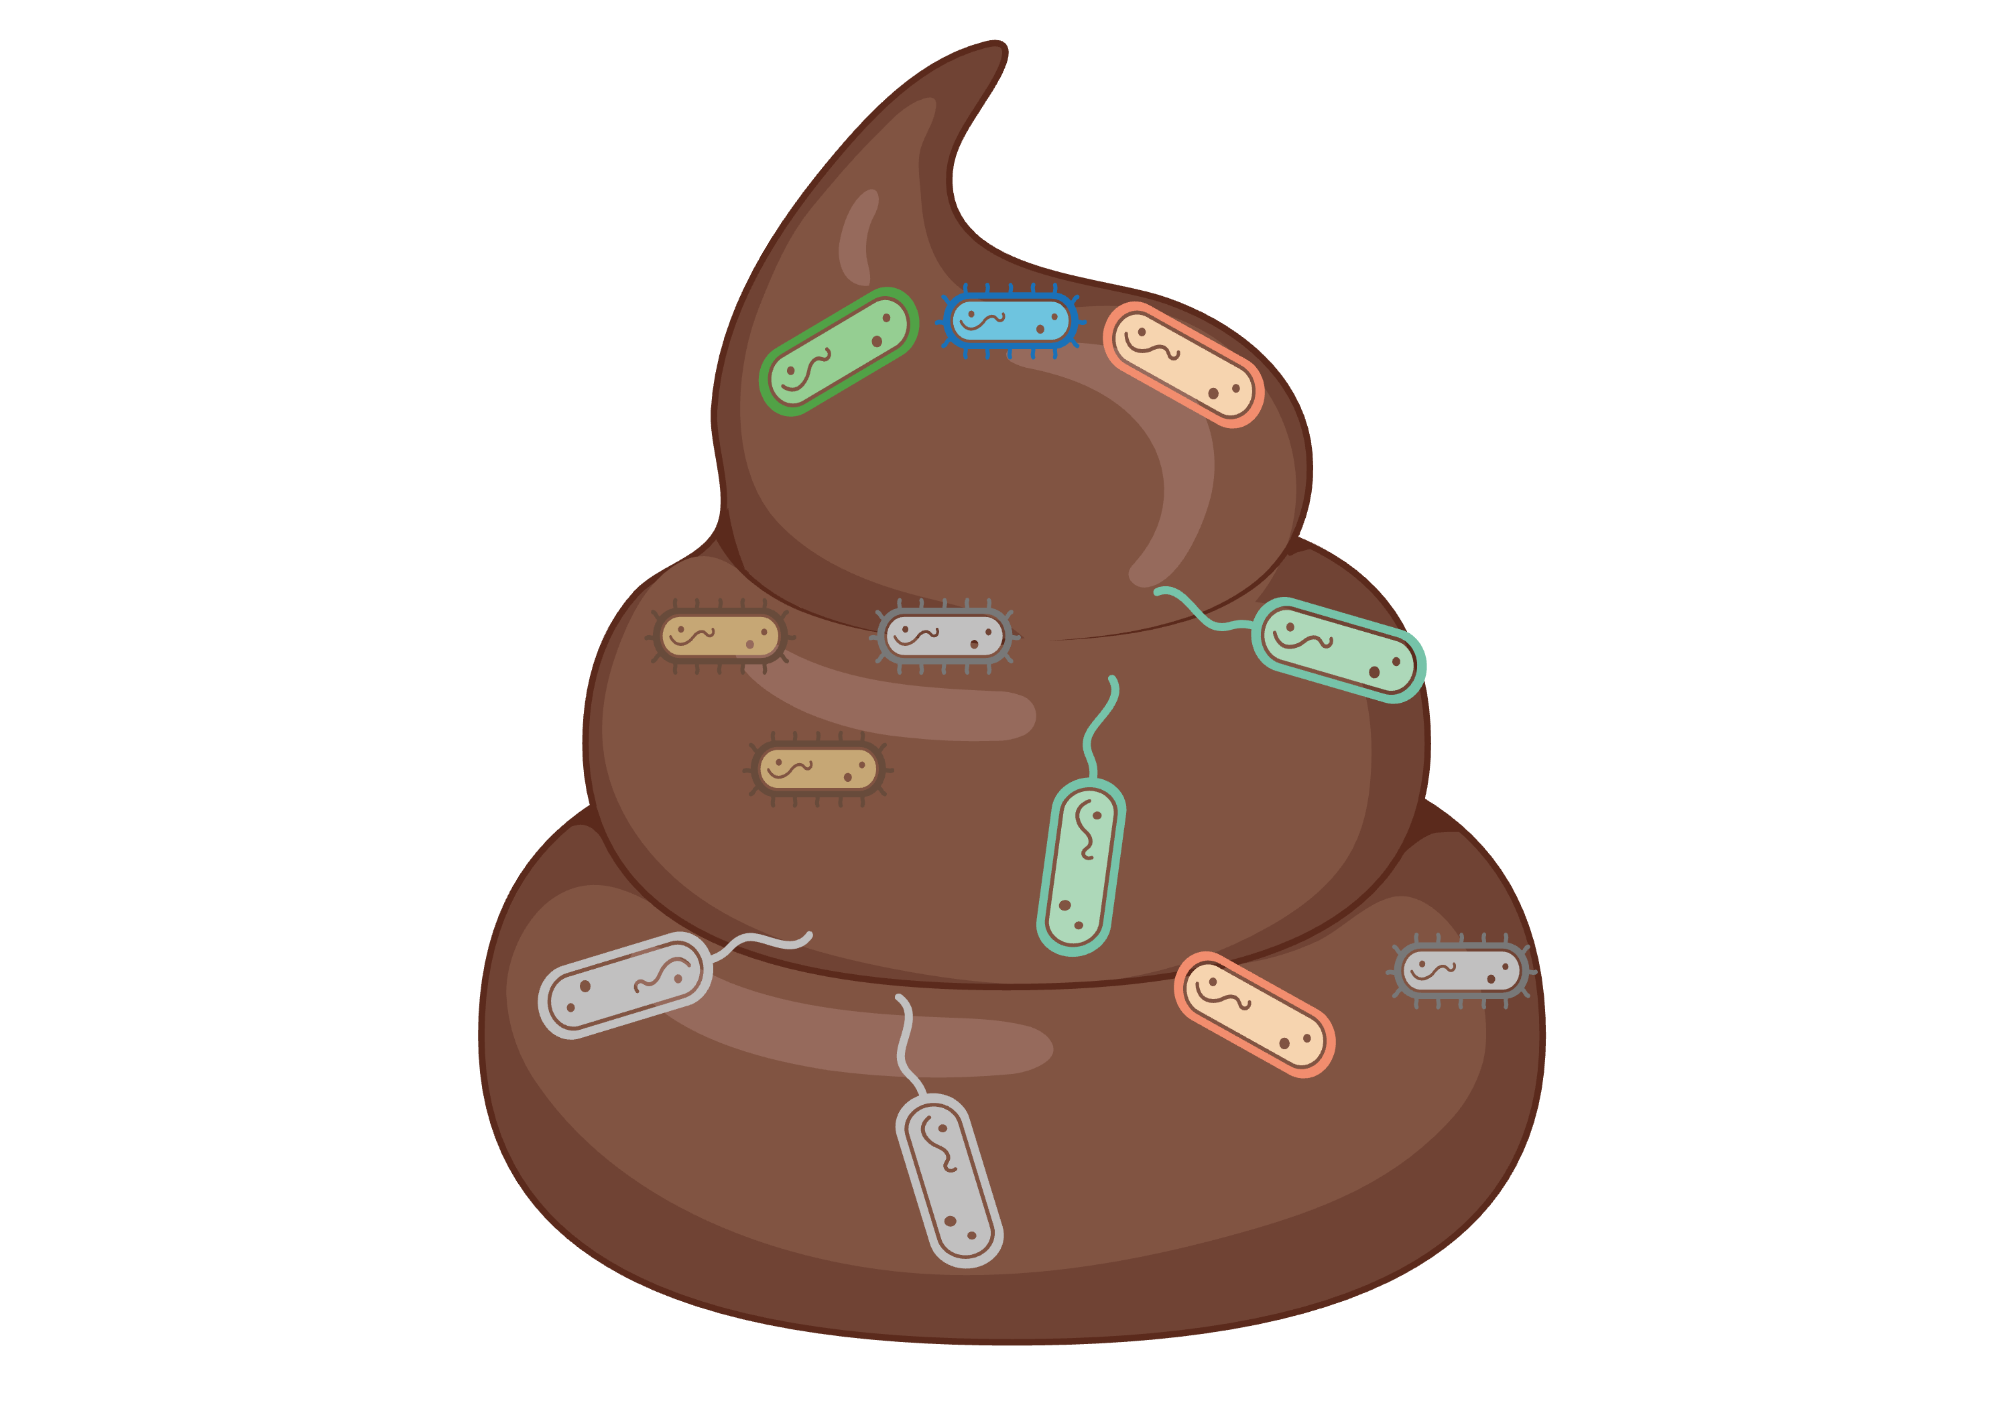

Dataset Overview
Non Redundant Species + Clinical
Species*
Species + Clinical
Only Species
Genus*
Genus + Clinical
Only Genus
Pathways*
Pathways + Clinical
Only Pathways
*Taxa, w/, w/o clinical information & minus redundant features
Notes:
Clinical information consists of
Leptin: satiety hormone — signals to brain that body has sufficient hunger
Ghrelin: hunger hormone — signals to brain to eat
Resting metabolitic rate — amount of energy body needs to maintain basic physiological functions
Ethnicity
Etc
Pathways: species and genus bugs make things, and these pathways represent the functions they are capable of

Slide 13
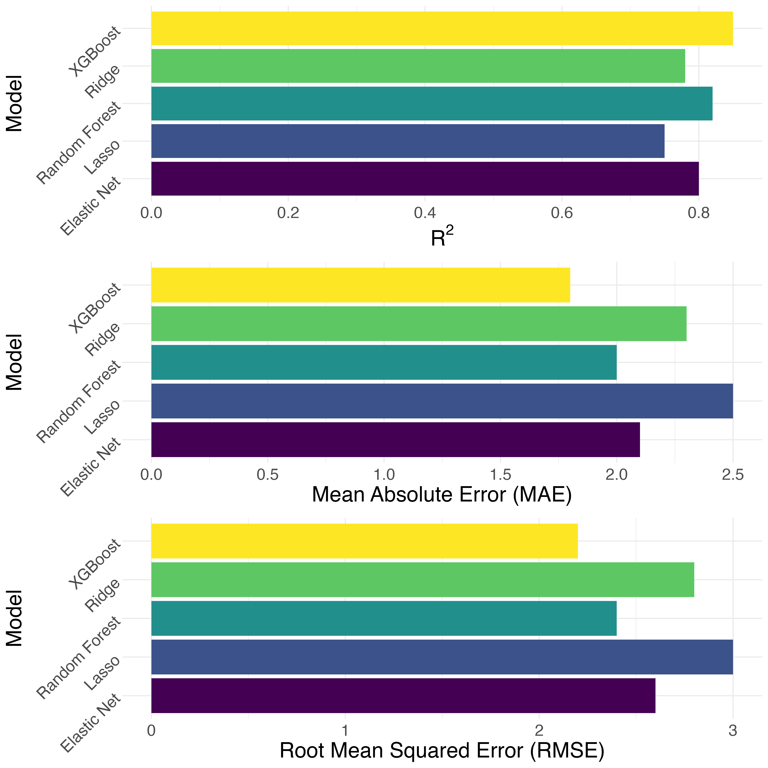
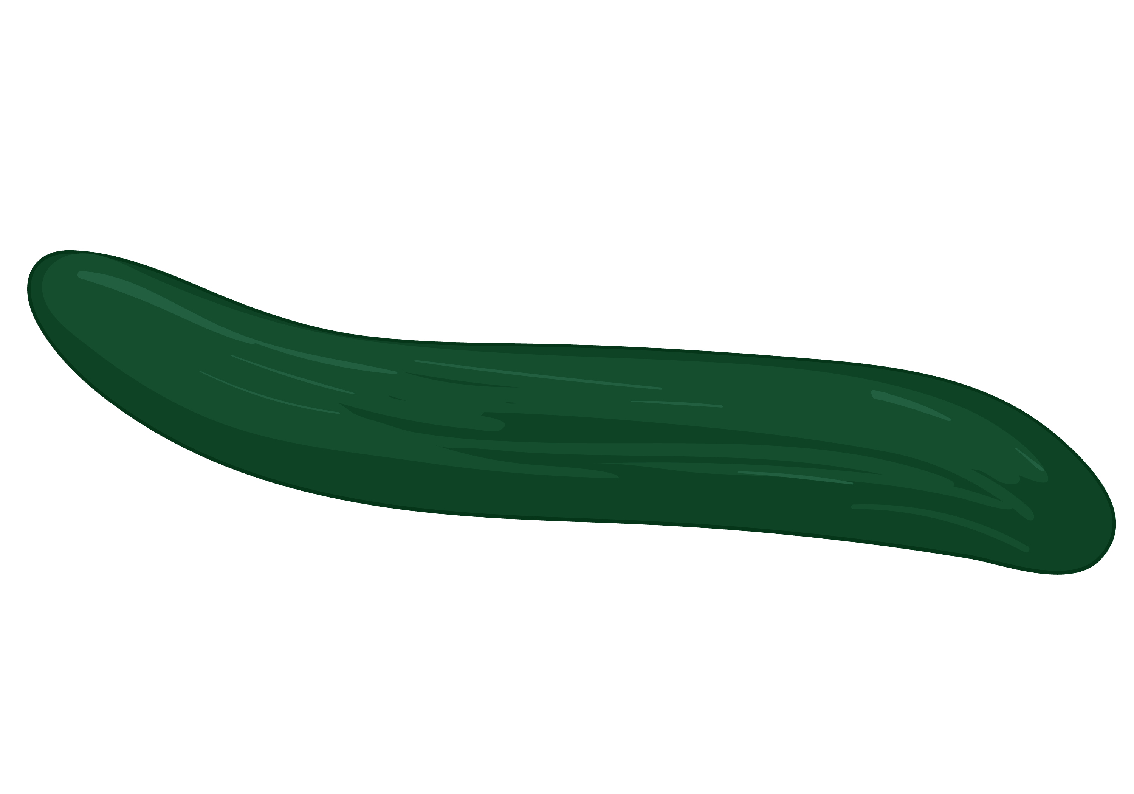
Dataset, Models, and Metrics Overview
Datasets
Models
Metrics
Species*
Species
Species
Penalized Regression Models
Elastic Net
Lasso
Ridge
Genus*
Genus
Genus
Ensemble Learning Methods
Random Forest
XGBoost
Pathways*
Pathways
Pathways
*Taxa, w/, w/o clinical information & minus redundant features
Notes:
Penalized Regression Models: Extensions of linear regression that include a penalty term to prevent overfitting. They are effective for finding linear trends while managing complexity (e.g., Ridge, Lasso).
Ensemble Learning Methods: Combine multiple models (e.g., decision trees) to capture complex, non-linear relationships between features (e.g., Random Forest, Gradient Boosting).

Slide 14
Dataset, Models, and Metrics Overview
Datasets
Models
Metrics
Species*
Species
Species
Penalized Regression Models
Elastic Net
Lasso
Ridge
Genus*
Ensemble Learning Methods
Random Forest
XGBoost
Pathways*
*Taxa, w/, w/o clinical information & minus redundant features

Slide 15
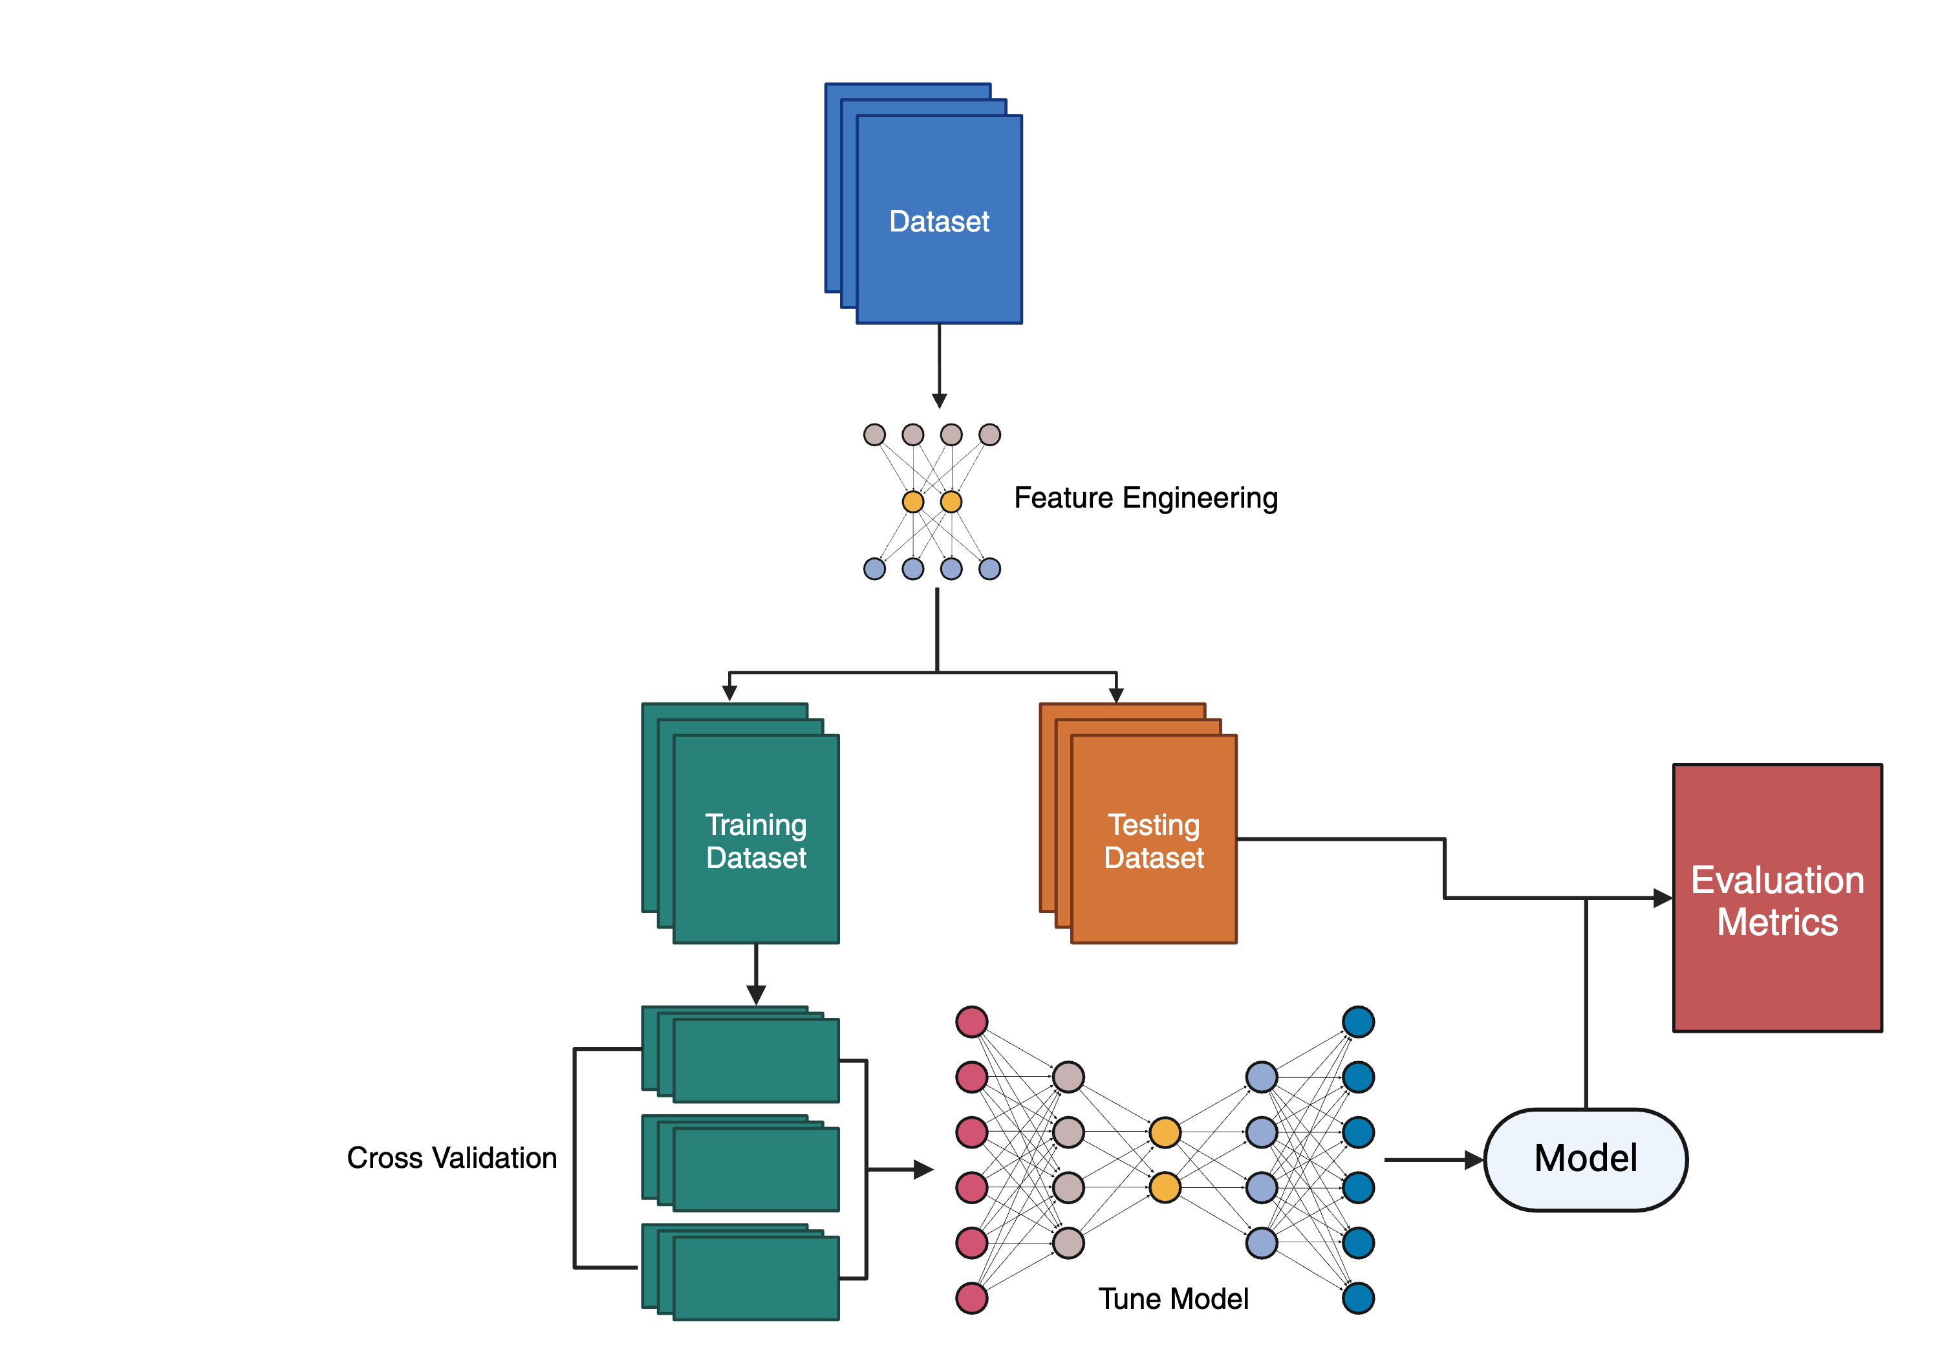
Overview of Machine Learning Models
Patients | g_Dorea | g_Clostridum | Leptin
AMl-325 | 45 | 56 | 12
KSJ-458 | 89 | 75 | 8
DFJ-489 | 43 | 57 | 1
WPS-239 | 57 | 89 | 19
BMI*
27
30.5
32.5
35
Understand and Prepare Data
Feature Engineering
Split the Dataset
Train the Model
Test and Evaluate the Model
Interpret and Communicate the Results
Iterate and Improve
Notes:
Include cross val, and tune model to numbers

Slide 16
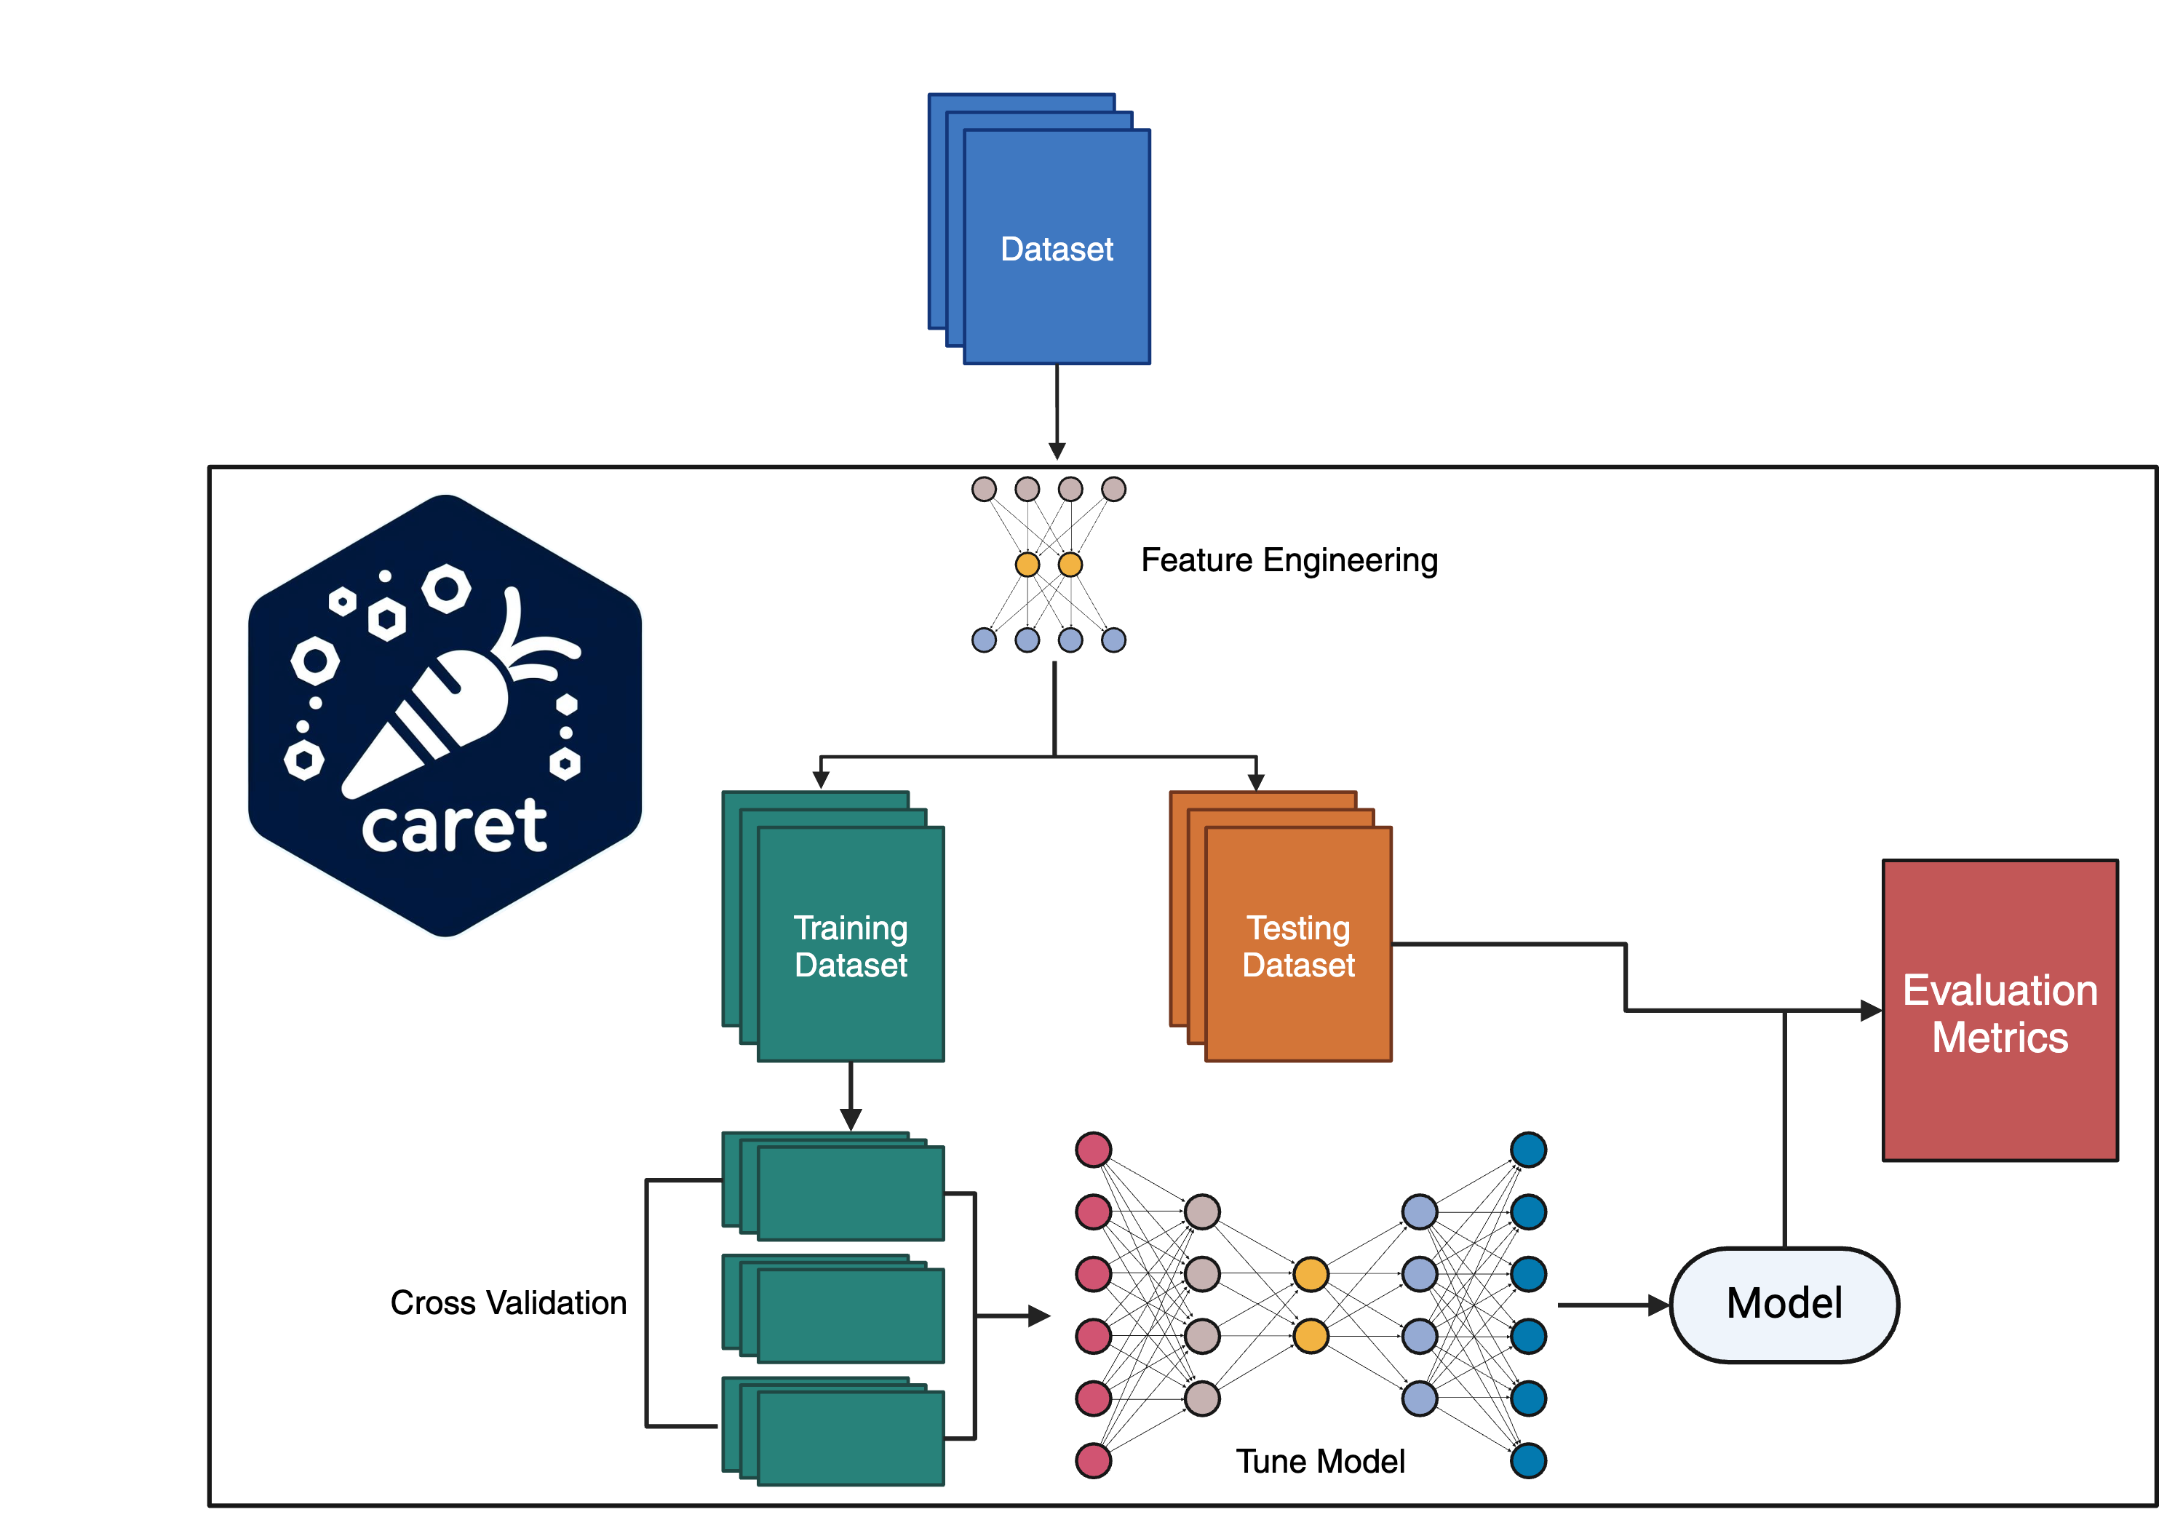
Overview of Machine Learning Models
Patients | g_Dorea | g_Clostridum | Leptin
AMl-325 | 45 | 56 | 12
KSJ-458 | 89 | 75 | 8
DFJ-489 | 43 | 57 | 1
WPS-239 | 57 | 89 | 19
BMI*
27
30.5
32.5
35
Understand and Prepare Data
Feature Engineering
Split the Dataset
Train the Model*
Test and Evaluate the Model
Interpret and Communicate the Results
Iterate and Improve
*Train:Test Split & Cross
Validation

Slide 17
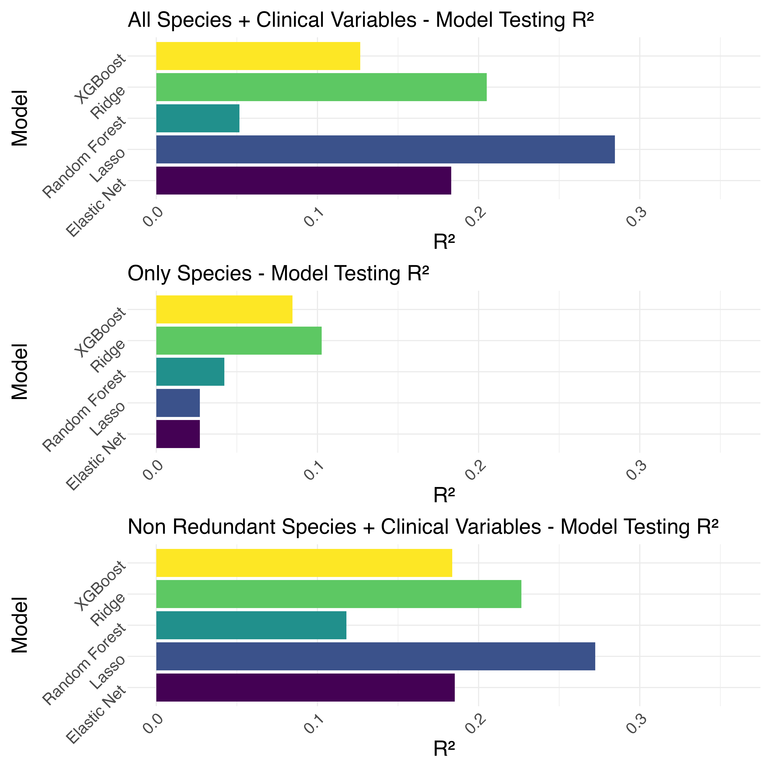

Test $R^{2}$ Metrics

Slide 18
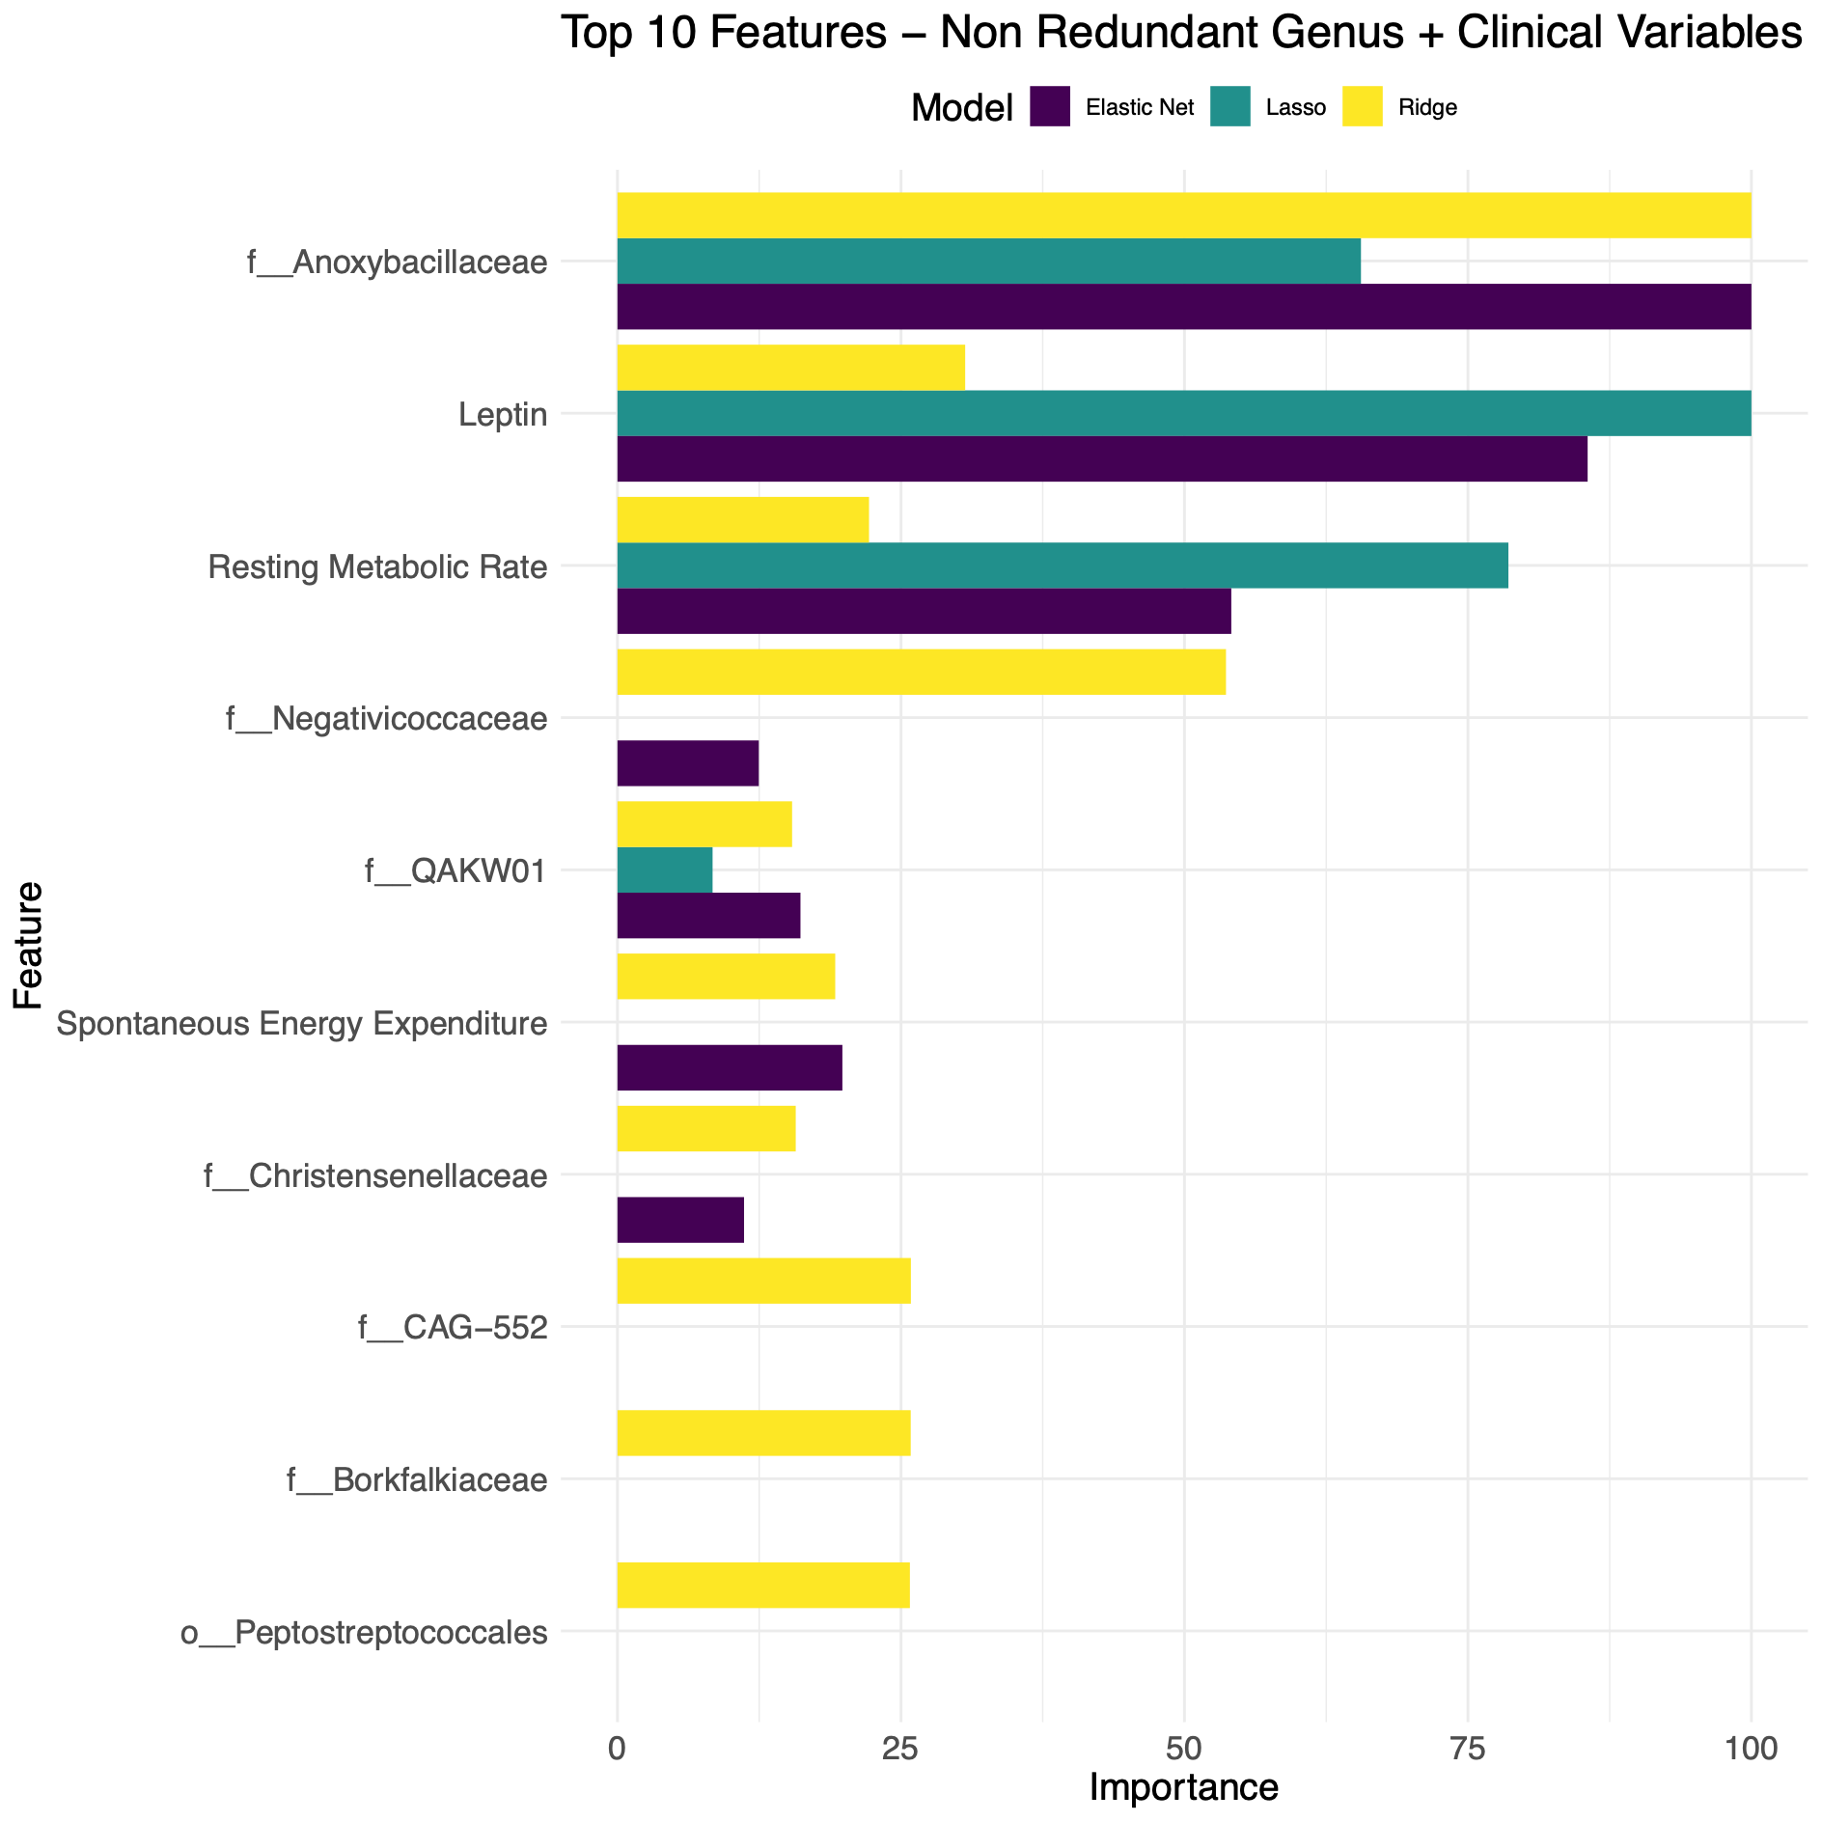
Comparing Top 10 Features Across Models

Slide 19
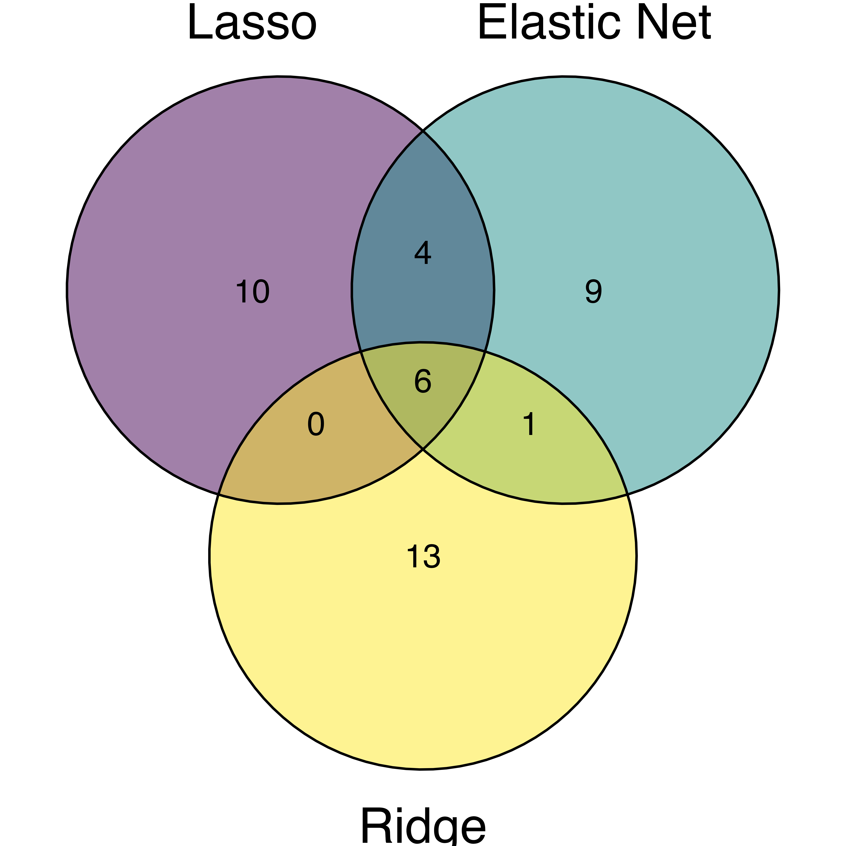
Non Redundant Species + Clinical Variables Top 20 Features Venn diagram
Feature Comparison
Lasso
Elastic Net
Ridge

Slide 20

Species and Pathways Feature Comparison
Non Redundant Species + Clinical Variables Top 20 Features Venn diagram
All Pathways + Clinical Variables Top 20 Features Venn diagram
Lasso
Elastic Net
Lasso
Elastic Net
Species*
Species
Pathways*
Species
Pathways
Pathways
Ridge
Ridge
Notes:
The overlap suggests that the species may be performing the same functions

Slide 21

Conclusions and Discussions
Gut Microbiota and Clinical Variables Influence BMI Discrepancies
Microbial species, genera, and pathways significantly associated with differences between actual and genetically predicted BMI
Key clinical features
Leptin
Total Daily Energy Expenditure
Resting Metabolic Rate
Homeostasis Model Assessment of Insulin Resistance (HOMA-IR)
Elastic Net, Lasso, and Ridge Performed Best
Testing $R^{2}$
Elastic Net: 0.35
Lasso: 0.27
Ridge: 0.26
Implications for Personalized Obesity Interventions
Identified features provide potential targets for tailored weight management strategies
Incorporating gut microbiota composition can refine obesity treatment approaches

Slide 22








Thank you
Dr. Maggie Stanislawski
Co-Authors:
Jennifer Fouquier
Cathy Lozupone
Danielle Ostendorf
Paul MacLean
Edward Melanson
Daniel Bessesen
Victoria Catenacci
Sarah Borengasser
Ashley Scadden
Funding:
K01: HL157658 (Stanislawski)
R01: DK111622 (Catenacci)
NSF: 2022138 (IQ Biology)
Emily Yeo

Slide 23
Questions?

